Slide 1

Title: Multimodal Data with Anomaly Techniques for Object Detection and Tracking in Autonomous Driving
Group 18
Revathy Iswarya Sekaran (11625243) – Sec 001
Dharshani Anandkumar (82653870) – Sec 002
Aksheya Kannan Subramanian (25502870) – Sec 002

Slide 2
Project objective and Scope:
Objective: The main goal of this project is to perform object detection and anomaly detection using YOLOv5 and YOLOv8 on the Waymo Open Dataset, identifying and classifying objects in images while flagging anomalies based on detected classes and confidence scores.
Scope:
Efficient data parsing from Waymo Open Dataset.
Anomaly detection based on model outputs.
Evaluation of model consistency using Intersection over Union (IoU).
Work split-up:
Revathy Iswarya Sekaran (11625243): Data Preprocessing, Model Development, YOLOv8 with Anomaly detection technique, Project Presentation.
Aksheya Kannan Subramanian (25502870): Model Development, Model Evaluation.
Dharshani Anandkumar (82653870): Model Development, Technology Researcher, Report Writing.

Slide 3
Data Introduction
Dataset Description:
The Waymo Perception Dataset includes high-resolution LiDAR and camera data from autonomous vehicles.
We have used subset of Waymo Perception Dataset: Data for 3D Camera-Only Detection Challenge, with 80 segments of 20s camera imagery specifically curated for visual-based 3D object detection and anomaly detection.
Data Source: Waymo Open Dataset
Data Size: 80 Tfrecords each one with 900+ images. Total images: 56,550
Data Transfer: Data was efficiently transferred to Google Drive using Google Cloud's gsutil tool, ensuring easy access and management for further processing.

Slide 4
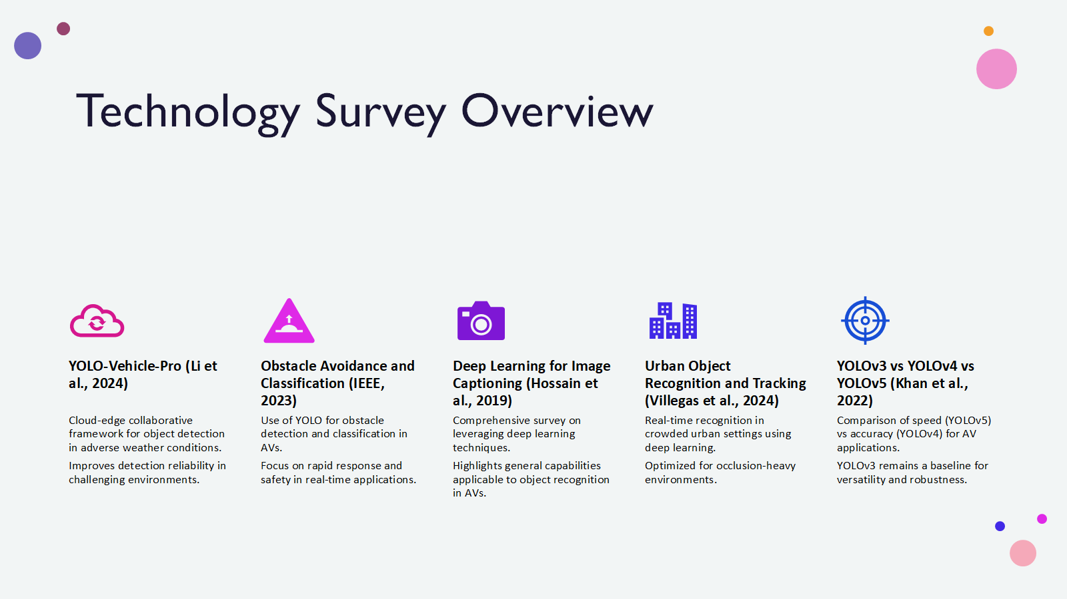

Slide 5
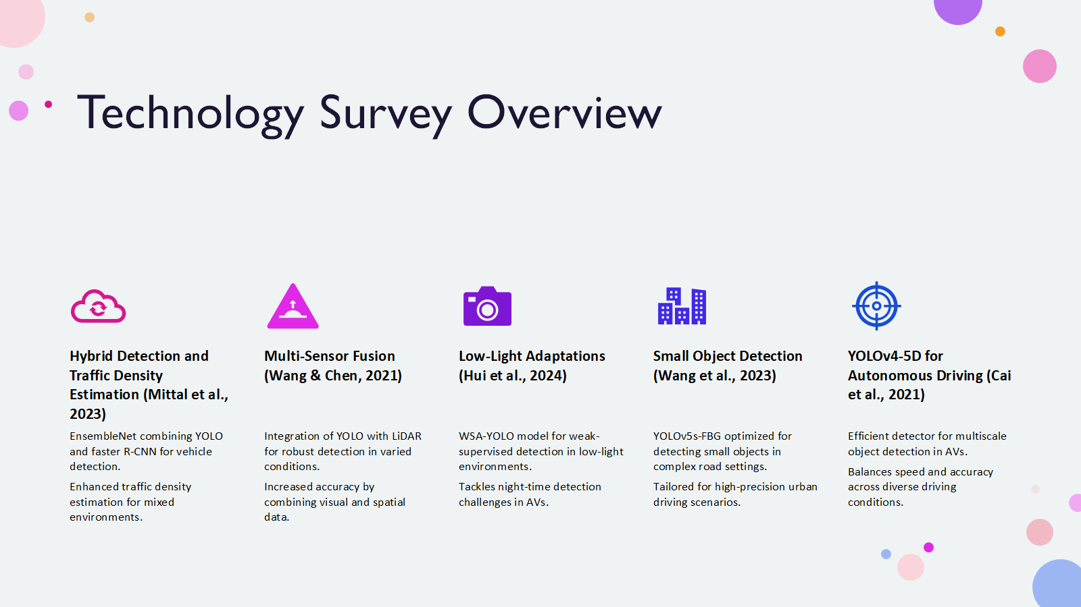

Slide 6
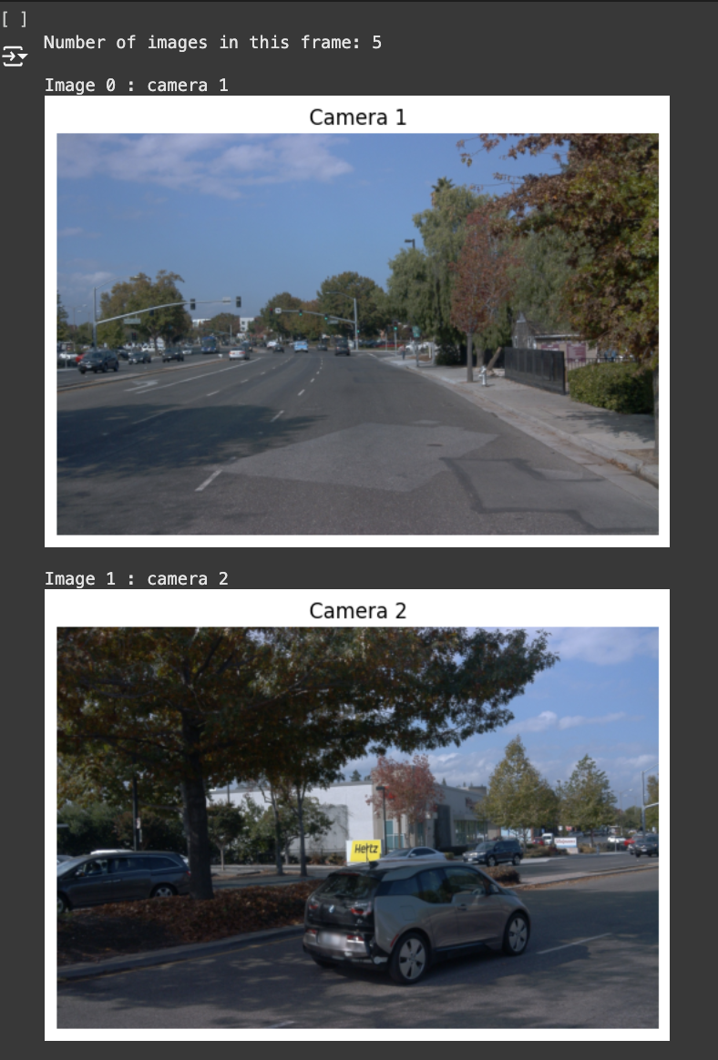
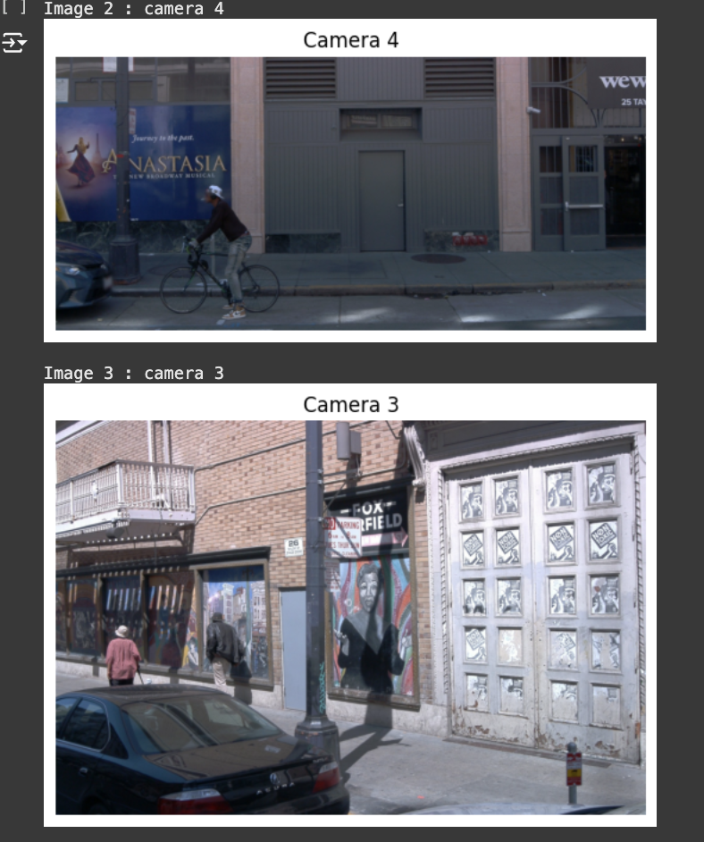
Visualization:

Slide 7
Technologies and Models Used:
YOLOv5:
Integrated YOLOv5 for 2D object detection.
Processed images from multiple TFRecord files, visualized detection results, and saved outputs for further analysis and evaluation.
YOLOv8 with Anomaly Detection Technique:
Utilized YOLOv8's pretrained model for efficient object detection in the Waymo dataset, offering higher performance and efficiency.
Implemented a Threshold-based Anomaly Detection Technique:
Flagged anomalies if the detected class was not one of the expected classes (e.g., Car, Person, Truck).
Flagged anomalies if the confidence score was less than 0.5.

Slide 8
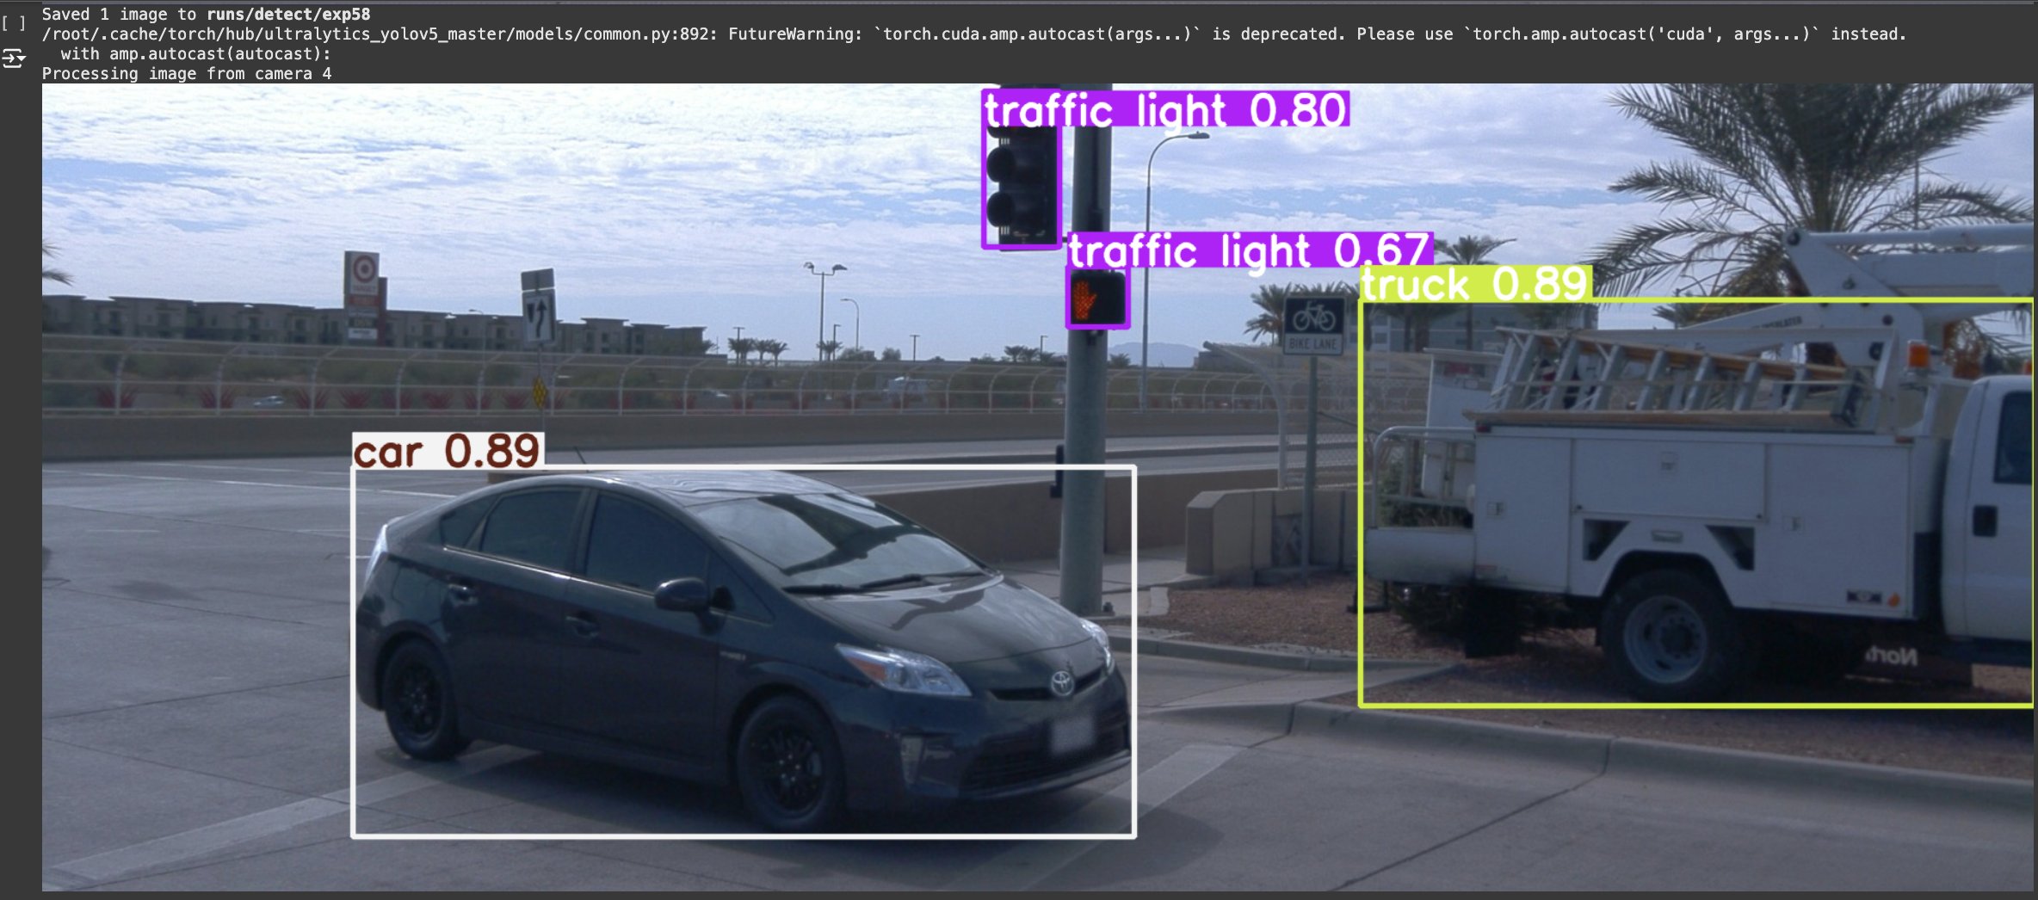
Results of YOLOv5:

Slide 9
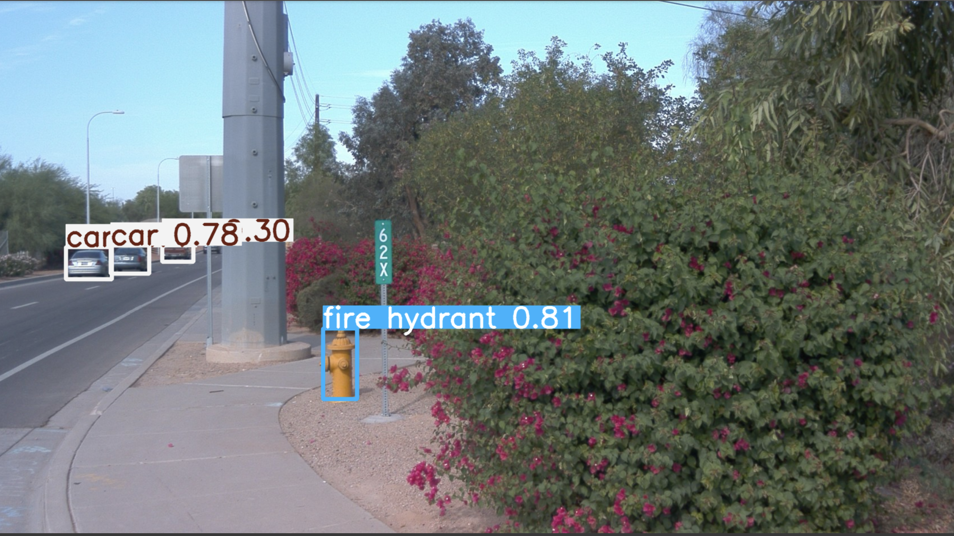

Slide 10
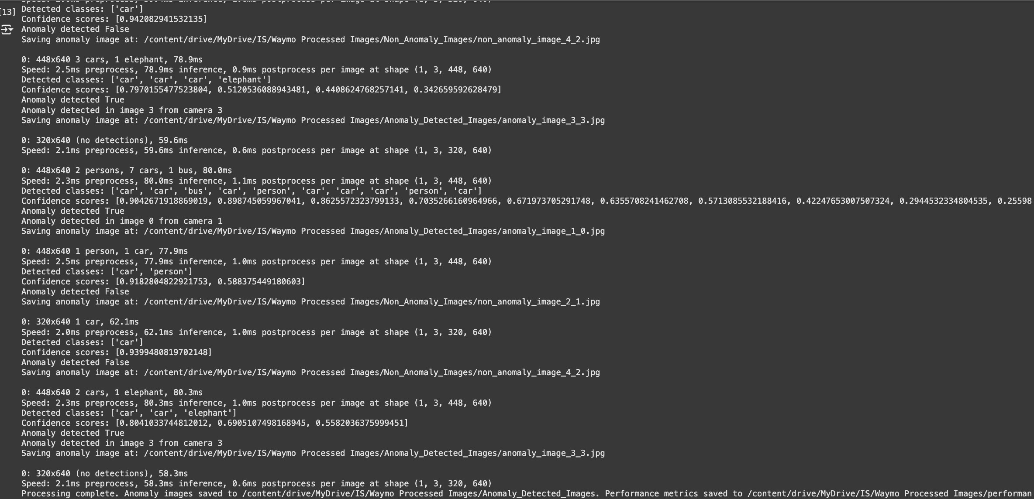
YOLOv8 object and anomaly detection results of first 2 TFRecords:

Slide 11
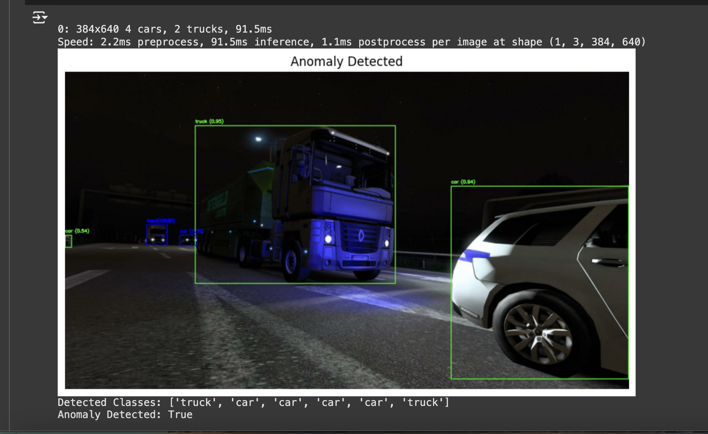
Prediction results of random unseen images with and without vehicles:

Slide 12
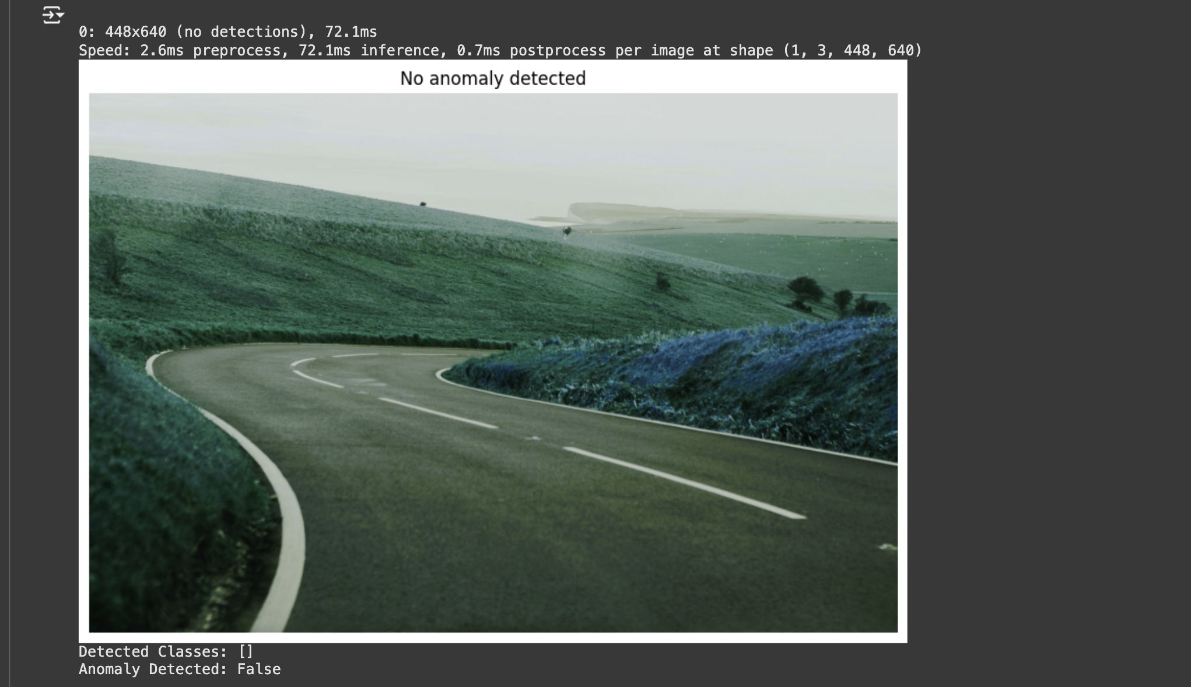

Slide 13
Technologies and Models Used:
Metrics: Intersection over Union (IoU): IoU is a common metric for evaluating the performance of object detection models which is used to measure the overlap between two bounding boxes. In the absence of ground truth, IoU is calculated between the model's predicted bounding boxes to evaluate their overlap and consistency. Frequency of Anomalies detected: Visualize the number of images flagged as anomalies versus non-anomalies. Confidence Scores distribution: Plot the distribution of confidence scores for all the detections across images.

Slide 14
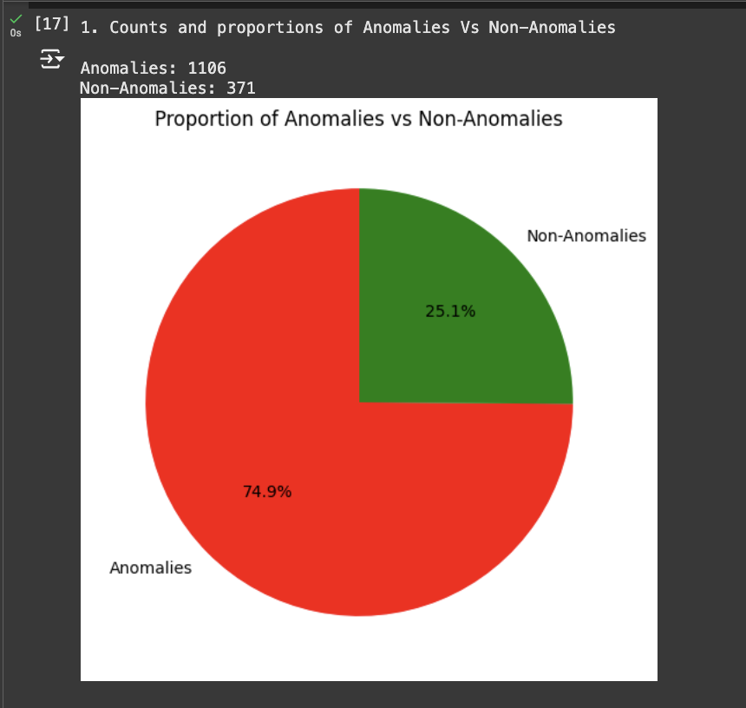
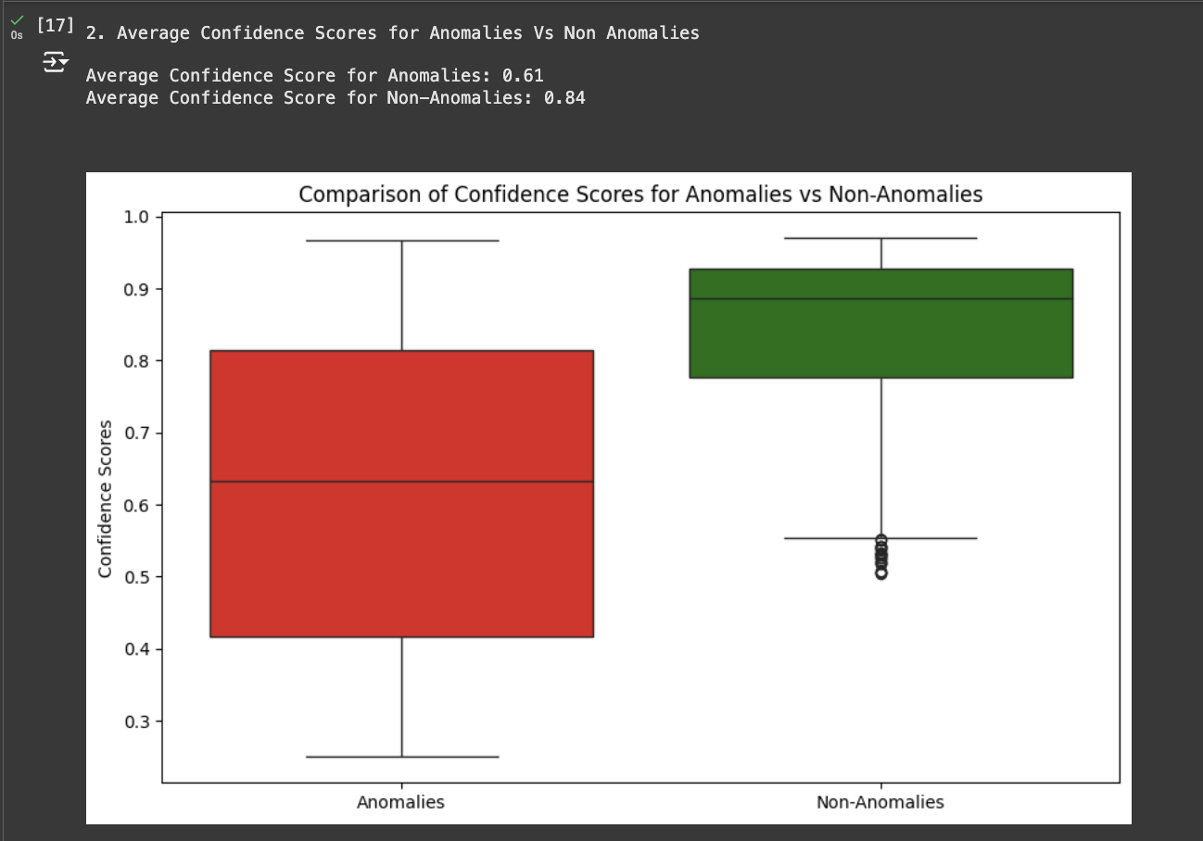
Proportion of Anomalies Vs Non-Anomalies:

Slide 15
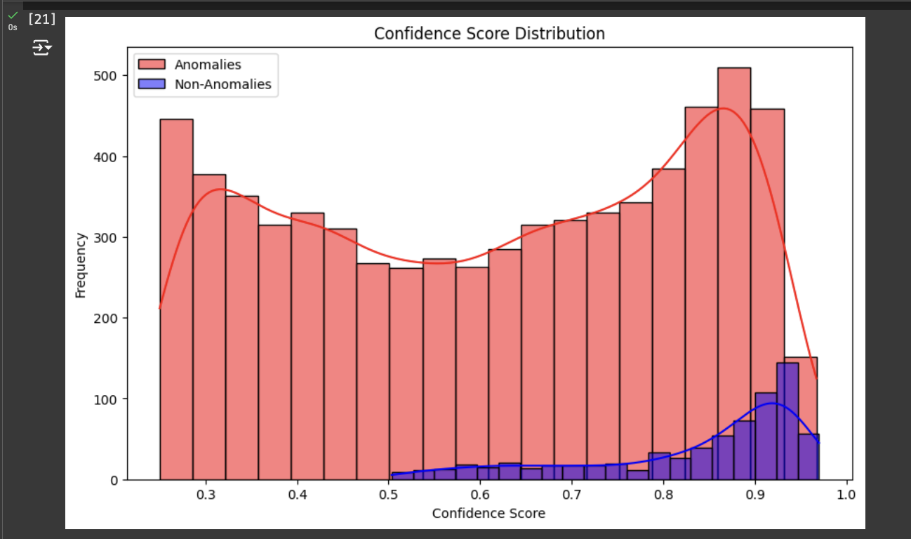
Confidence score distribution:
Inference: The confidence score distribution shows that the YOLOv8 model is highly reliable in identifying non-anomalous instances, with scores clustering near 1.0. Anomalous instances display a broader range of confidence scores, indicating variability in detection certainty. This demonstrates the model's ability to effectively distinguish between normal and abnormal cases.

Slide 16
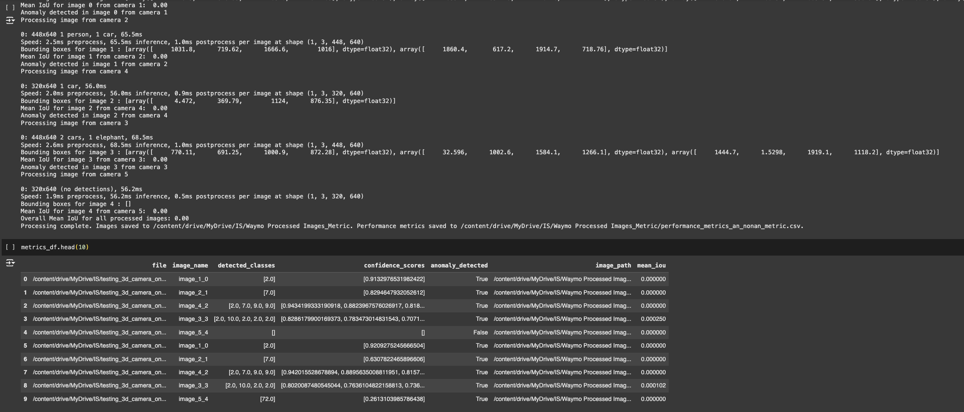
IoU(Intersection over Union):

Slide 17
Conclusion:
Developed a real-time object and anomaly detection system for autonomous vehicles using YOLOv5 and YOLOv8.
Achieved reliable object detection and anomaly classification with high confidence scores and bounding box alignment.
Evaluated performance using confidence score distribution and IoU metrics in the absence of ground truth data.
Gained expertise in handling large datasets, model implementation, and visualization.
Future enhancement includes incorporating 3D models and tracking algorithms for improved system performance.

Slide 18
Challenges and Limitations:
Processing large TFRecord files with multiple high resolution images requires significant computational resources, especially processing data on pre-trained models like YOLOv8.
Lack of ground truth data for validation.
Anomaly detection challenges (e.g., defining clear thresholds).
Model consistency when comparing predicted boxes without ground truth

Slide 19
References
[1] Li, X., et al. (2024). "YOLO-Vehicle-Pro: A Cloud-Edge Collaborative Framework for Object Detection in Autonomous Driving under Adverse Weather Conditions." arXiv preprint. Link to paper
[2] IEEE. (2023). "Autonomous Vehicle: Obstacle Avoidance and Classification with YOLO." IEEE Conference Publication. Link to paper
[3] Hossain, M. S., Sohel, F., Shiratuddin, M. F., & Laga, H. (2019). A comprehensive survey of deep learning for image captioning. MDPI. Link to paper
[4] W. E. Villegas, S. Sánchez-Viteri and S. Luján-Mora (2024) "Real-Time Recognition and Tracking in Urban Spaces Through Deep Learning: A Case Study," in IEEE Access, vol. 12, pp. 95599-95612 Link to paper
[5] Khan, S., Rahman, A. U., Jan, B., Farman, H., Muhammad, K., Anwar, H., & Sangaiah, A. K. (2022). “Comparing YOLOv3, YOLOv4 and YOLOv5 for Autonomous Landing Spot Detection in Faulty UAVs”. Sensors, 22(2), 464. Link to paper
[6] Mittal, U., Chawla, P. & Tiwari, R. (2023). “EnsembleNet: a hybrid approach for vehicle detection and estimation of traffic density based on faster R-CNN and YOLO models” Neural Comput & Applic 35, 4755–4774 Link to paper
[7] Wang, J., & Chen, Y. (2021). "Multi-Sensor Fusion with YOLO for Enhanced Detection in Autonomous Vehicles." Sensors, vol. 21, no. 10, pp. 3396. Link to paper
[8] Y. Hui, J. Wang and B. Li (2024) "WSA-YOLO: Weak-Supervised and Adaptive Object Detection in the Low-Light Environment for YOLOV7," in IEEE Transactions on Instrumentation and Measurement, vol. 73, pp. 1-12, Art no. 2507012 Link to paper
[9] P. Wang, Y. Yin, S. Fu, B. Liu, F. Yang and X. Wang (2023) "YOLOv5s-FBG: A Small Object Detection Method in Complex Road Background," 2023 International Conference on Blockchain Technology and Applications (ICBTA), Beijing, China, pp. 52-59 Link to paper
[10] Y. Cai et al. (2021) "YOLOv4-5D: An Effective and Efficient Object Detector for Autonomous Driving," in IEEE Transactions on Instrumentation and Measurement, vol. 70, pp. 1-13, Art no. 4503613. Link to paper

